Slide 1


An Interactive Dashboard for Building Energy-Efficient AI
Data Analytics Boot Camp
Final Project
Ali Syed, Darrin Ho, Kishore Ramakrishnan, Taskin Sarwat Khan, David E Gonzalez, and Yves-Andre Chapuis
New York City
Notes:
Good afternoon
My name is Tim Buckley, for the last four years I have been a portfolio manager for the Sydney based firm of Arkx, a specialist investor in large, global listed clean energy firms.
I’ll focus my introductory comments on four points:
Fossil fuels are Inflationary; Renewable Energy is Deflationary.
India’s Electricity System is dominated by Thermal capacity, and the country’s entire energy structure is fundamentally flawed.
India has a well established base of distributed Renewable Energy – Hydro, Run-of-River, Solar, Wind and Biomass; and it is already cost competitive with unsubsidised thermal. Wind PPAs are Rs4.60/w, below PPAs for new thermal projects, and solar is rapidly coming down; wholesale parity by 2016.
There are some strong plans for RE from the Indian Government with increasing Corporate support.
I have a lot of slides, so I’ll go very quickly to get through this presentation in 15 minutes.

Slide 2

1
Goals
Goals
The 4 Main Goals of the Project
1. Develop a Full Stack Data Science Project*
All what we learned!
2. Apply Data Analytics to Technological Change
e.g. Energy & Environment
3. Focus on Data Visualization & Machine Learning Concepts
Machine Learning Interactive Dashboard
4. Elaborate a Prototype for Mobile App (Future)
New startup idea
*Project Inspired from Literature
A Complete Machine Learning Project Walk-Through in Python (2018)
William Koehrsen, Towards Data Science (Educator Website: Sharing concepts, ideas, and code)
Notes:
For the last few decades, fossil fuels have been a major inflationary factor across the global. Accepting some regional variances, oil, coal and gas prices have all been rising. Fossil fuels have been an inflationary force globally.
Shale gas in the US has been revolutionary in its economic impact. However, at US$3-4/MMBTU – this is not reflective of world gas prices – US$15 in Japan & US$10-12 in EU. Australia has been paying US$3-4, but is set to go to US$8 by 2016.

Slide 3

2
Team
Team
The Team!
Ali Syed
Darrin Ho
Kishore Ramakrishnan
Taskin Sarwat Khan
David E Gonzalez
Yves-Andre Chapuis
Notes:
For the last few decades, fossil fuels have been a major inflationary factor across the global. Accepting some regional variances, oil, coal and gas prices have all been rising. Fossil fuels have been an inflationary force globally.
Shale gas in the US has been revolutionary in its economic impact. However, at US$3-4/MMBTU – this is not reflective of world gas prices – US$15 in Japan & US$10-12 in EU. Australia has been paying US$3-4, but is set to go to US$8 by 2016.

Slide 4



3
How to Calculate the ENERGY STAR Score?
ENERGY
STAR
URL: https://www.energystar.gov/
Score
0 - 100
Features from
Buildings in NYC
Building ID, Type, Location, etc.
Site Energy Use Intensity (kBtu/ft²)
Weather Normalized Site Energy Use Intensity (kBtu/ft²)
Total GreenHouse Gases Emissions (MtCO2e)
DOF Property Floor Area
Notes:
For the last few decades, fossil fuels have been a major inflationary factor across the global. Accepting some regional variances, oil, coal and gas prices have all been rising. Fossil fuels have been an inflationary force globally.
Shale gas in the US has been revolutionary in its economic impact. However, at US$3-4/MMBTU – this is not reflective of world gas prices – US$15 in Japan & US$10-12 in EU. Australia has been paying US$3-4, but is set to go to US$8 by 2016.

Slide 5
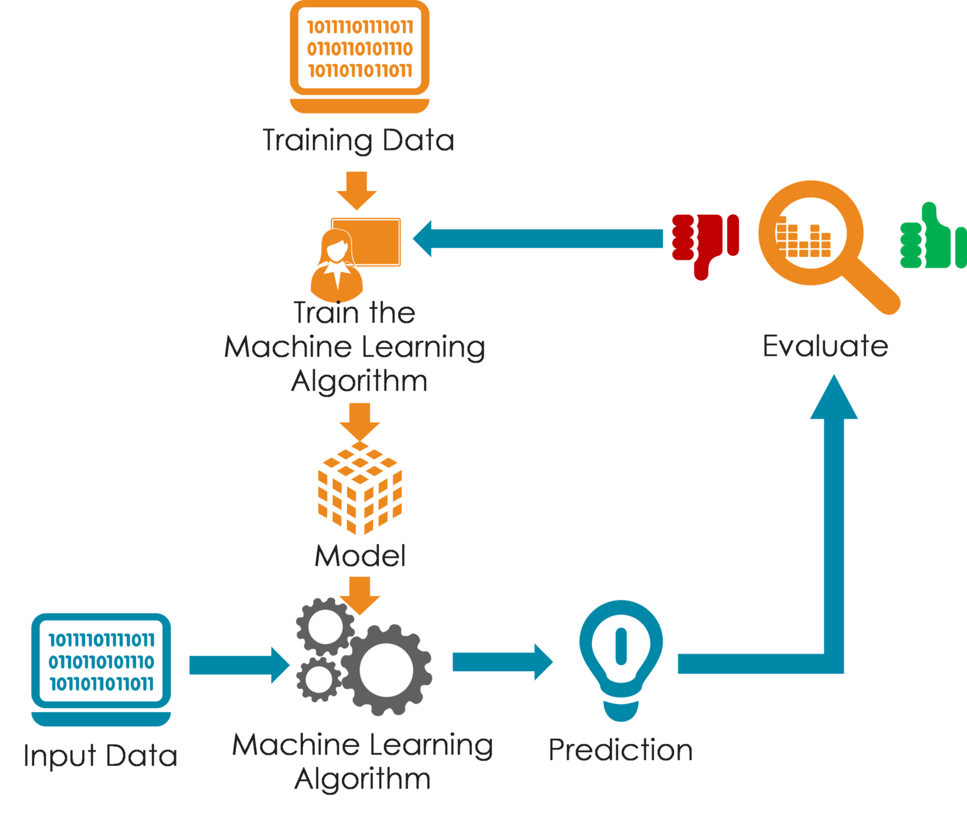
4
Machine Learning Approach
ML
Approach
Score
0 - 100
Features from
Buildings in NYC
Notes:
For the last few decades, fossil fuels have been a major inflationary factor across the global. Accepting some regional variances, oil, coal and gas prices have all been rising. Fossil fuels have been an inflationary force globally.
Shale gas in the US has been revolutionary in its economic impact. However, at US$3-4/MMBTU – this is not reflective of world gas prices – US$15 in Japan & US$10-12 in EU. Australia has been paying US$3-4, but is set to go to US$8 by 2016.

Slide 6



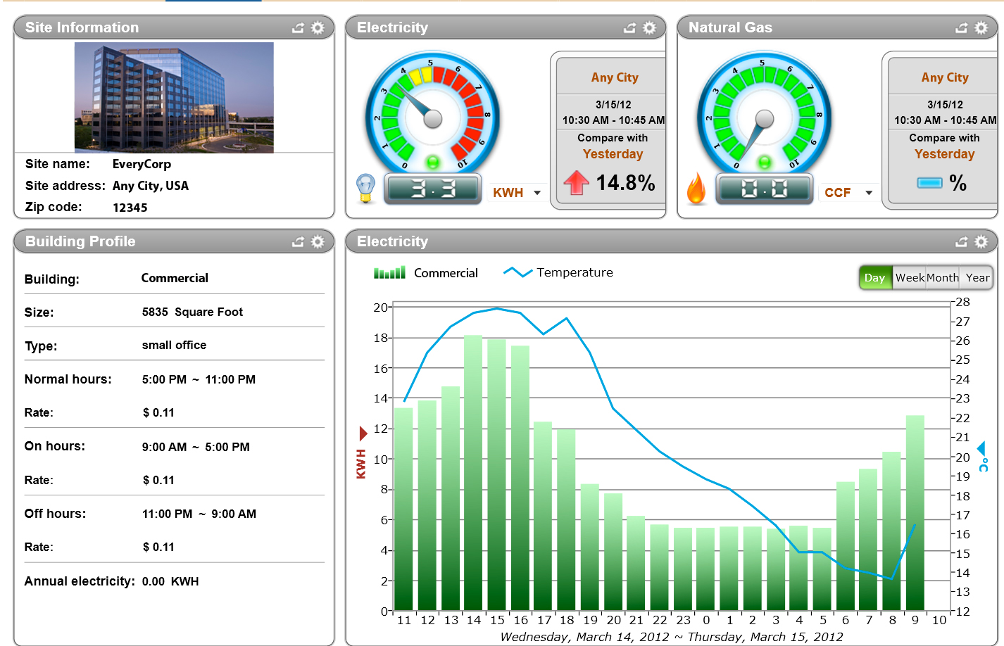
5
Our Project’s Architecture
Our
Architecture
Application for Predicting ENERGY STAR Score
Data Processing
Visualization
Features from Buildings in NYC
Dashboard
Notes:
For the last few decades, fossil fuels have been a major inflationary factor across the global. Accepting some regional variances, oil, coal and gas prices have all been rising. Fossil fuels have been an inflationary force globally.
Shale gas in the US has been revolutionary in its economic impact. However, at US$3-4/MMBTU – this is not reflective of world gas prices – US$15 in Japan & US$10-12 in EU. Australia has been paying US$3-4, but is set to go to US$8 by 2016.

Slide 7
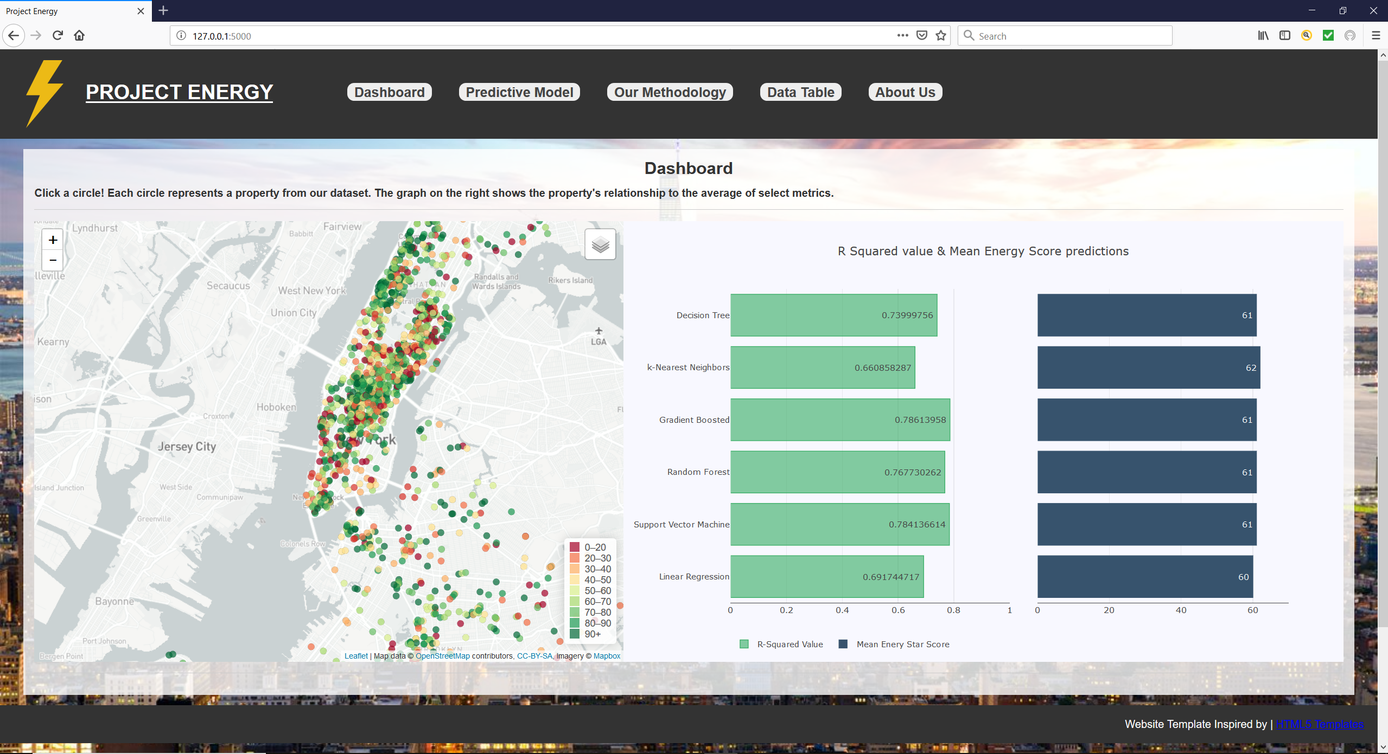






5
Our Project’s Architecture
Our
Architecture
Development Tools!
Data Processing
Visualization
Pandas
Jupyter Notebook
Dashboard
Notes:
For the last few decades, fossil fuels have been a major inflationary factor across the global. Accepting some regional variances, oil, coal and gas prices have all been rising. Fossil fuels have been an inflationary force globally.
Shale gas in the US has been revolutionary in its economic impact. However, at US$3-4/MMBTU – this is not reflective of world gas prices – US$15 in Japan & US$10-12 in EU. Australia has been paying US$3-4, but is set to go to US$8 by 2016.

Slide 8
6
Dashboard
Dashboard
1. Layout
2. Predictive
Model
Analysis
3. Application
1. Layout
Mapping of NYC Building
Predictive ENERGY STAR Score for each Building
Notes:
For the last few decades, fossil fuels have been a major inflationary factor across the global. Accepting some regional variances, oil, coal and gas prices have all been rising. Fossil fuels have been an inflationary force globally.
Shale gas in the US has been revolutionary in its economic impact. However, at US$3-4/MMBTU – this is not reflective of world gas prices – US$15 in Japan & US$10-12 in EU. Australia has been paying US$3-4, but is set to go to US$8 by 2016.

Slide 9
6
Dashboard
Dashboard
1. Layout
2. Predictive
Model
Analysis
3. Application
2. Predictive Model Analysis
Notes:
For the last few decades, fossil fuels have been a major inflationary factor across the global. Accepting some regional variances, oil, coal and gas prices have all been rising. Fossil fuels have been an inflationary force globally.
Shale gas in the US has been revolutionary in its economic impact. However, at US$3-4/MMBTU – this is not reflective of world gas prices – US$15 in Japan & US$10-12 in EU. Australia has been paying US$3-4, but is set to go to US$8 by 2016.

Slide 10
6
Dashboard
Dashboard
1. Layout
2. Predictive
Model
Analysis
3. Application
3. Application
Notes:
For the last few decades, fossil fuels have been a major inflationary factor across the global. Accepting some regional variances, oil, coal and gas prices have all been rising. Fossil fuels have been an inflationary force globally.
Shale gas in the US has been revolutionary in its economic impact. However, at US$3-4/MMBTU – this is not reflective of world gas prices – US$15 in Japan & US$10-12 in EU. Australia has been paying US$3-4, but is set to go to US$8 by 2016.

Slide 11
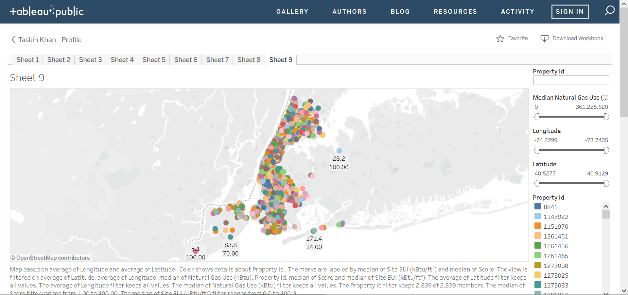
7
Tableau
Tableau
Notes:
For the last few decades, fossil fuels have been a major inflationary factor across the global. Accepting some regional variances, oil, coal and gas prices have all been rising. Fossil fuels have been an inflationary force globally.
Shale gas in the US has been revolutionary in its economic impact. However, at US$3-4/MMBTU – this is not reflective of world gas prices – US$15 in Japan & US$10-12 in EU. Australia has been paying US$3-4, but is set to go to US$8 by 2016.

Slide 12

8
Conclusion
Conclusion
1. Develop a Full Stack Data Science Project*
2. Apply Data Analytics to Technological Change
3. Focus on Data Visualization & Machine Learning Concepts
4. Elaborate a Prototype for Mobile App (Future)
To Continue…
Notes:
For the last few decades, fossil fuels have been a major inflationary factor across the global. Accepting some regional variances, oil, coal and gas prices have all been rising. Fossil fuels have been an inflationary force globally.
Shale gas in the US has been revolutionary in its economic impact. However, at US$3-4/MMBTU – this is not reflective of world gas prices – US$15 in Japan & US$10-12 in EU. Australia has been paying US$3-4, but is set to go to US$8 by 2016.

Slide 13
Appendix
Notes:
For the last few decades, fossil fuels have been a major inflationary factor across the global. Accepting some regional variances, oil, coal and gas prices have all been rising. Fossil fuels have been an inflationary force globally.
Shale gas in the US has been revolutionary in its economic impact. However, at US$3-4/MMBTU – this is not reflective of world gas prices – US$15 in Japan & US$10-12 in EU. Australia has been paying US$3-4, but is set to go to US$8 by 2016.

Slide 14
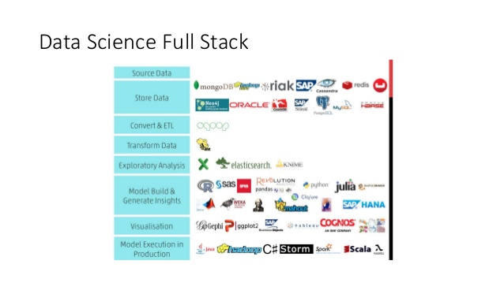
Appendix
Notes:
For the last few decades, fossil fuels have been a major inflationary factor across the global. Accepting some regional variances, oil, coal and gas prices have all been rising. Fossil fuels have been an inflationary force globally.
Shale gas in the US has been revolutionary in its economic impact. However, at US$3-4/MMBTU – this is not reflective of world gas prices – US$15 in Japan & US$10-12 in EU. Australia has been paying US$3-4, but is set to go to US$8 by 2016.

Slide 15

Appendix
2. Modeling Energy Usage in New York City
https://medium.com/ibm-data-science-experience/modeling-energy-usage-in-new-york-city-d55aece80b
Objectives:
Create a project and collaborate with other data scientists.
Create an easy-to-use application to make the outcome of the models consumable by any user.
Easily import data into a notebook from object storage to quickly start analyzing data and creating predictive models.
Model energy usage of buildings in kWh.
Identify buildings that consume energy inefficiently.
Notes:
For the last few decades, fossil fuels have been a major inflationary factor across the global. Accepting some regional variances, oil, coal and gas prices have all been rising. Fossil fuels have been an inflationary force globally.
Shale gas in the US has been revolutionary in its economic impact. However, at US$3-4/MMBTU – this is not reflective of world gas prices – US$15 in Japan & US$10-12 in EU. Australia has been paying US$3-4, but is set to go to US$8 by 2016.

Slide 16
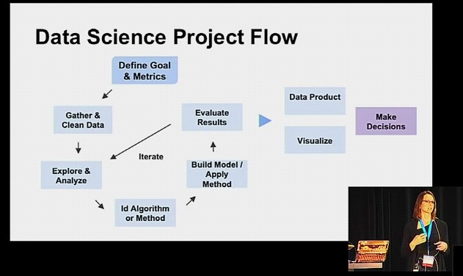
Appendix
Notes:
For the last few decades, fossil fuels have been a major inflationary factor across the global. Accepting some regional variances, oil, coal and gas prices have all been rising. Fossil fuels have been an inflationary force globally.
Shale gas in the US has been revolutionary in its economic impact. However, at US$3-4/MMBTU – this is not reflective of world gas prices – US$15 in Japan & US$10-12 in EU. Australia has been paying US$3-4, but is set to go to US$8 by 2016.

Slide 17
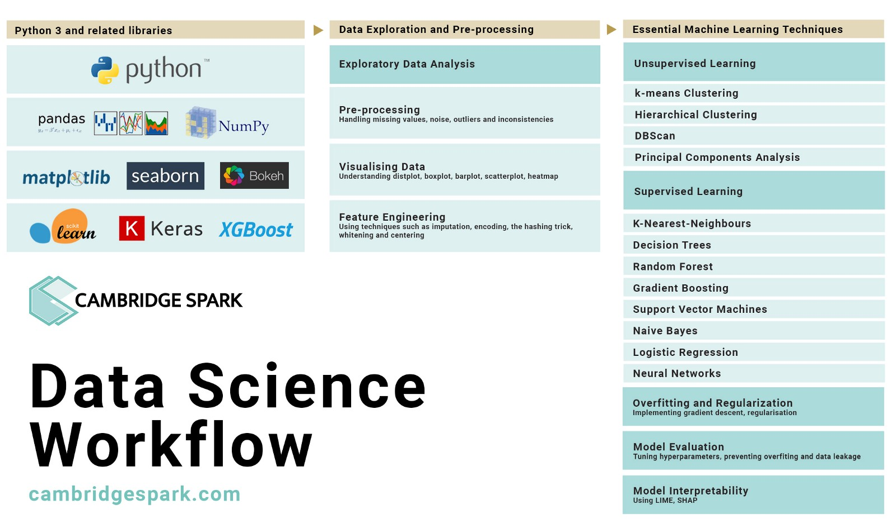
Appendix
Notes:
For the last few decades, fossil fuels have been a major inflationary factor across the global. Accepting some regional variances, oil, coal and gas prices have all been rising. Fossil fuels have been an inflationary force globally.
Shale gas in the US has been revolutionary in its economic impact. However, at US$3-4/MMBTU – this is not reflective of world gas prices – US$15 in Japan & US$10-12 in EU. Australia has been paying US$3-4, but is set to go to US$8 by 2016.

Slide 18
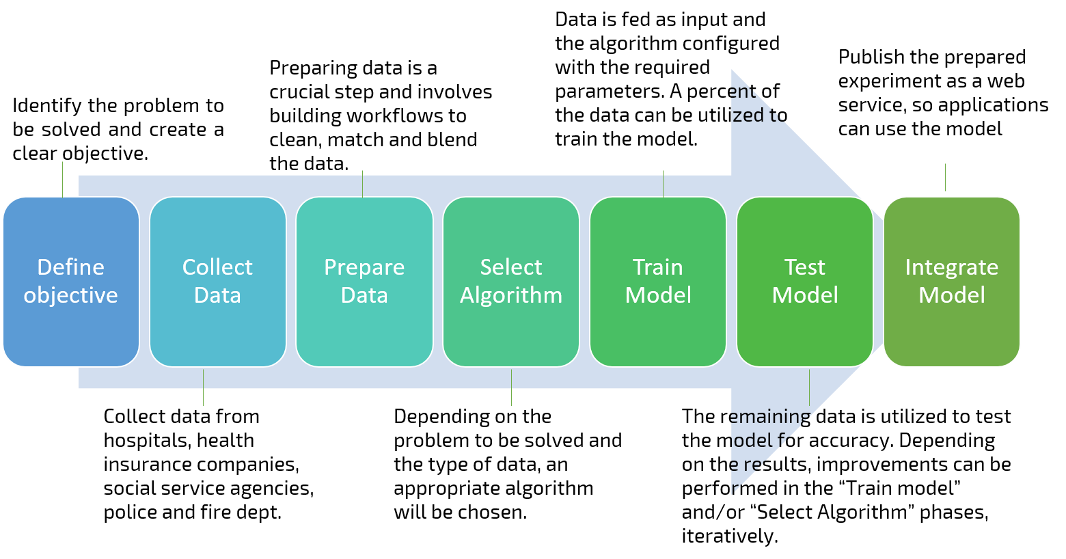
Appendix
Notes:
For the last few decades, fossil fuels have been a major inflationary factor across the global. Accepting some regional variances, oil, coal and gas prices have all been rising. Fossil fuels have been an inflationary force globally.
Shale gas in the US has been revolutionary in its economic impact. However, at US$3-4/MMBTU – this is not reflective of world gas prices – US$15 in Japan & US$10-12 in EU. Australia has been paying US$3-4, but is set to go to US$8 by 2016.

Slide 19


Appendix
Computer Apps
Mobile Apps
Notes:
For the last few decades, fossil fuels have been a major inflationary factor across the global. Accepting some regional variances, oil, coal and gas prices have all been rising. Fossil fuels have been an inflationary force globally.
Shale gas in the US has been revolutionary in its economic impact. However, at US$3-4/MMBTU – this is not reflective of world gas prices – US$15 in Japan & US$10-12 in EU. Australia has been paying US$3-4, but is set to go to US$8 by 2016.

Slide 20
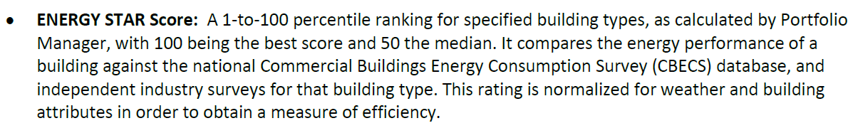
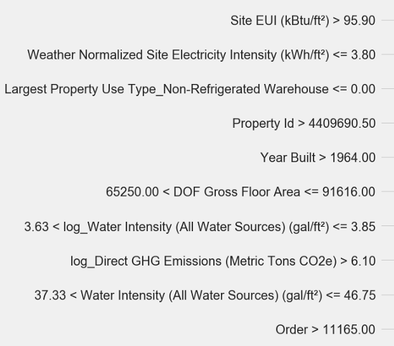
Appendix
Notes:
For the last few decades, fossil fuels have been a major inflationary factor across the global. Accepting some regional variances, oil, coal and gas prices have all been rising. Fossil fuels have been an inflationary force globally.
Shale gas in the US has been revolutionary in its economic impact. However, at US$3-4/MMBTU – this is not reflective of world gas prices – US$15 in Japan & US$10-12 in EU. Australia has been paying US$3-4, but is set to go to US$8 by 2016.

Slide 21







4
Technical Architecture
Workflow
Front End
Development
Back End Development
Web browser
ORM
Flask SQLAlchemy
Database
SQLite
Mobile Apps
Statistical Analysis Tools
Pandas
Jupyter Notebook
Data Engineering & Data Analysis
Notes:
For the last few decades, fossil fuels have been a major inflationary factor across the global. Accepting some regional variances, oil, coal and gas prices have all been rising. Fossil fuels have been an inflationary force globally.
Shale gas in the US has been revolutionary in its economic impact. However, at US$3-4/MMBTU – this is not reflective of world gas prices – US$15 in Japan & US$10-12 in EU. Australia has been paying US$3-4, but is set to go to US$8 by 2016.

